Slide 1


Comparative analysis of energy consumption and emissions of different hyper-parameter optimization algorithms
Presented by: Nadir ARFI
Student number: c7302112
Supervisor: Dr Ah-Lian Kor
Module: ICT and Environment

Slide 2
Outline
1. Introduction
2. Methodology
3. Findings and discussions
4. Conclusion

Slide 3
1. Introduction

Slide 4
Background
Data-intensive age has seen a rapid growth in the amount of information processed.
AI solutions has taken over by exploiting this sheer amount of data to make predictions and provide evidence-based decisions.
Primary focus is to deliver a cost-effective solution that meets accuracy requirements.
Among the applications of AI systems recommendation systems, computer vision, advertising and user behavior analysis.

Slide 5
Environmental impact of ICT
Environmental Impact
Potential for (SDGs)
More resource consuming lifestyle exerts stress on the environment.
Contribution to GHG emissions is estimated at 2.8% (Life cycle and supply chain not accounted).
A deep learning model can generate 626,000 pounds of GHG, equivalent to the lifetime emissions of 5 cars.
Enhance the ability to detect, adapt and respond to climate change.
Assist in a more cost-efficient surveillance and management of the world’s natural resources.
Combat biodiversity loss.

Slide 6
Motivation and Objectives
Conduct a critical literature review of environmental impacts of the ICT and different applications of ML in the sector.
Carry out experiments to measure energy consumption and computational time of different algorithms while performing hyper-parameter tuning
Apply descriptive and inferential statistical analysis on collected data and analyse the differences between HPO algorithms.
Convert energy consumption to carbon footprint emissions.

Slide 7
2. Methodology

Slide 8
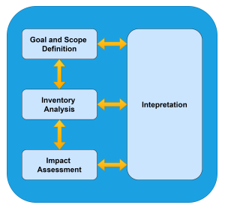
Macro Methodology
Life Cycle Analysis (LCA)
An essential tool for sustainable design and assessing environmental impacts.
Goal and Scope Definition:
Establishing research boundaries (python code).
Inventory Analysis:
Data acquisition via Joulemeter.
Impact assessment:
Measure impact in terms of energy and GHG emissions.
Interpretation:
Overall evaluation and provide recommendations and improvements.
Stages of LCA

Slide 9
Micro Methodology
Python libraries (scikit-learn, scitkit-optimize and NiaPy)
Different HPO algorithms used:
Grid Search (GS)
Random Search (RS)
Bayesian Optimization (BO)
Genetic Algorithm (GA)
Particle Swarm Optimization (PSO)
Energy monitoring tool (Joulemeter)
Carbon footprint Auditing Tool (DEFRA sheets)

Slide 10
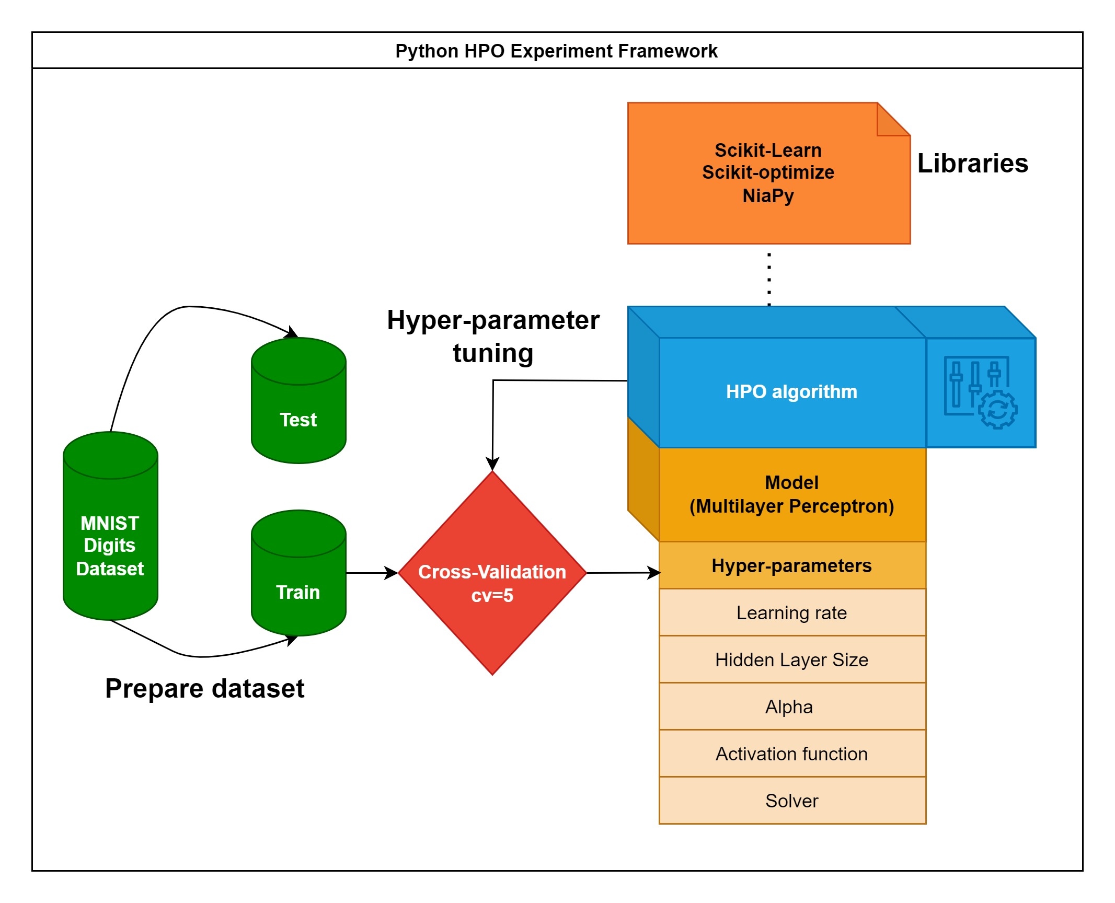
Python HPO Experiment Framework
A framework was built using different libraries.
Dataset was based on a simple digit classification task.
Multilayer perceptron HPs were selected to create the search space for these algorithms.
Every single experiment was conducted 10 times to guarantee the consistency of our analysis.

Slide 11
3. Findings and Discussion

Slide 12
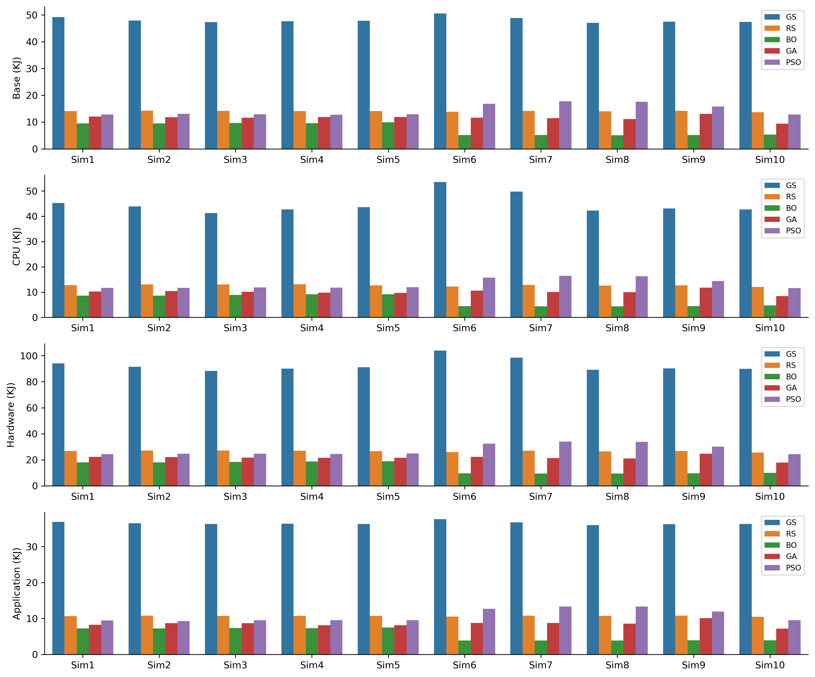
Energy consumption of different HPO algorithms within 10 simulations
Clearly, there is a significant difference in the energy consumption required for each algorithm.

Slide 13
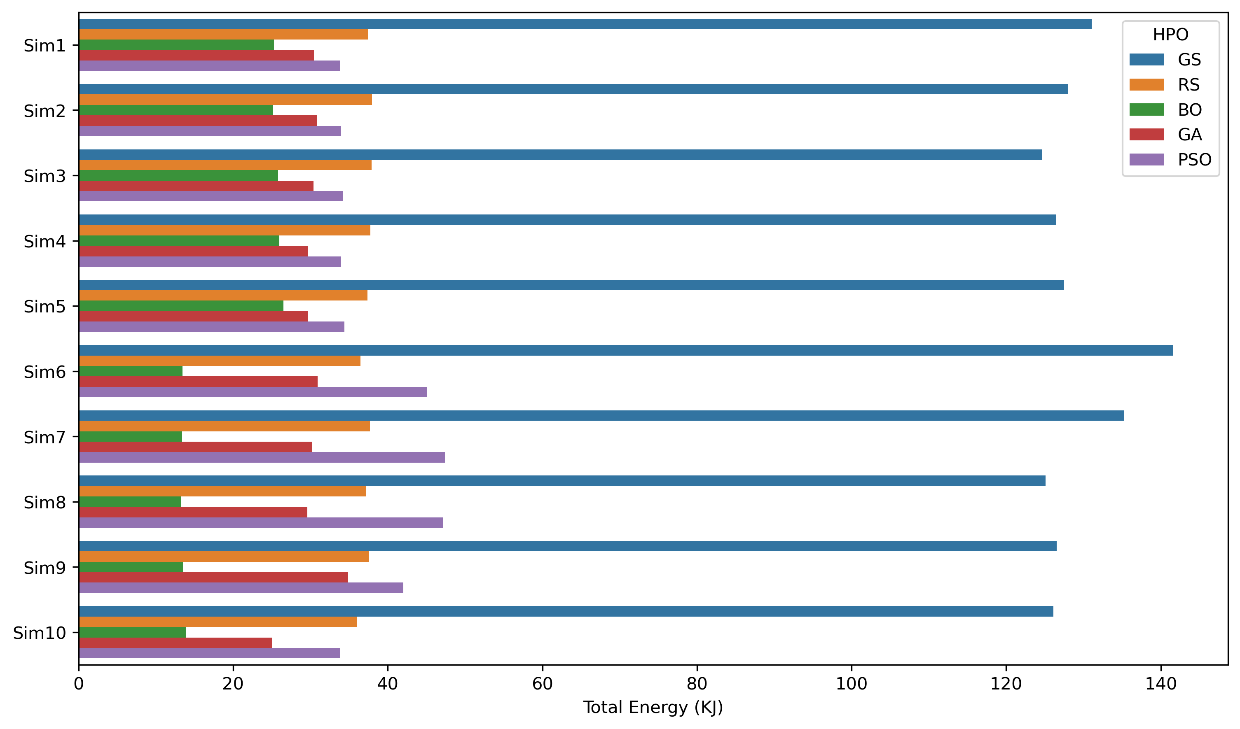
Total energy consumption measured in 10 simulations
Slight fluctuation in the total energy consumption for each algorithm, which could be accounted by errors in measurements.

Slide 14
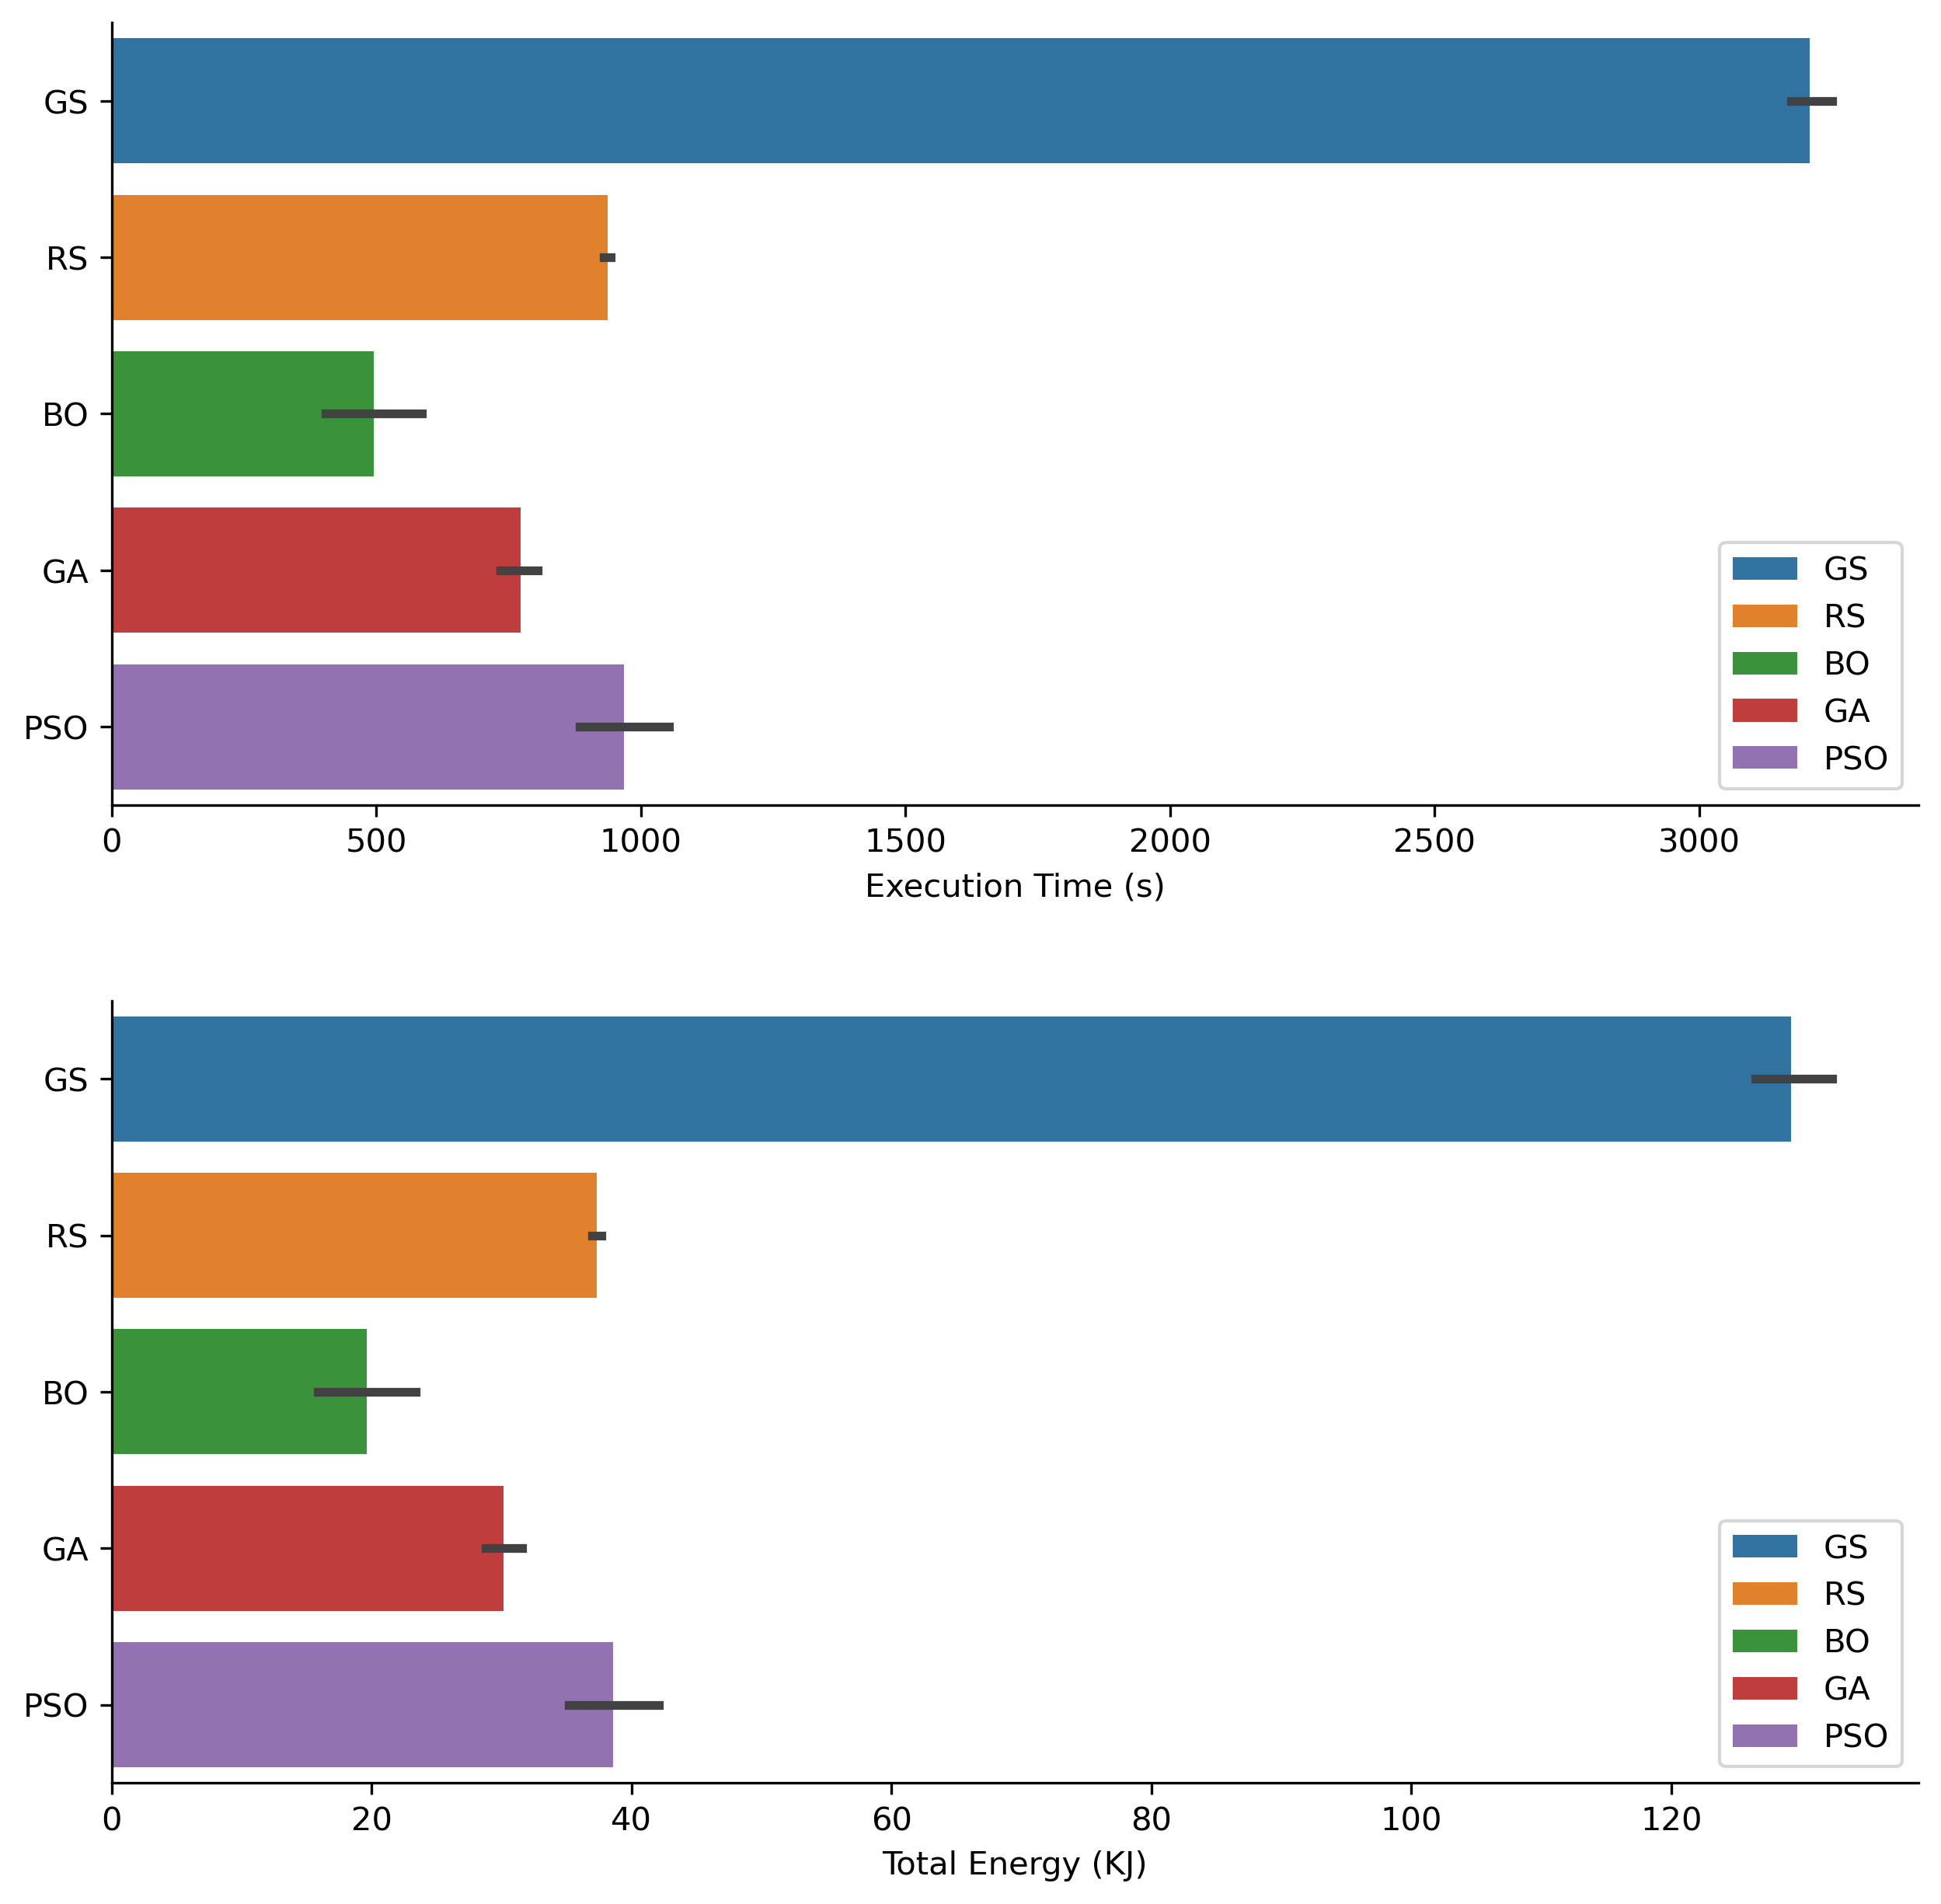
Total energy and execution time of different algorithms
There is a significant correlation between the amount of energy used and the execution time of the required task.

Slide 15
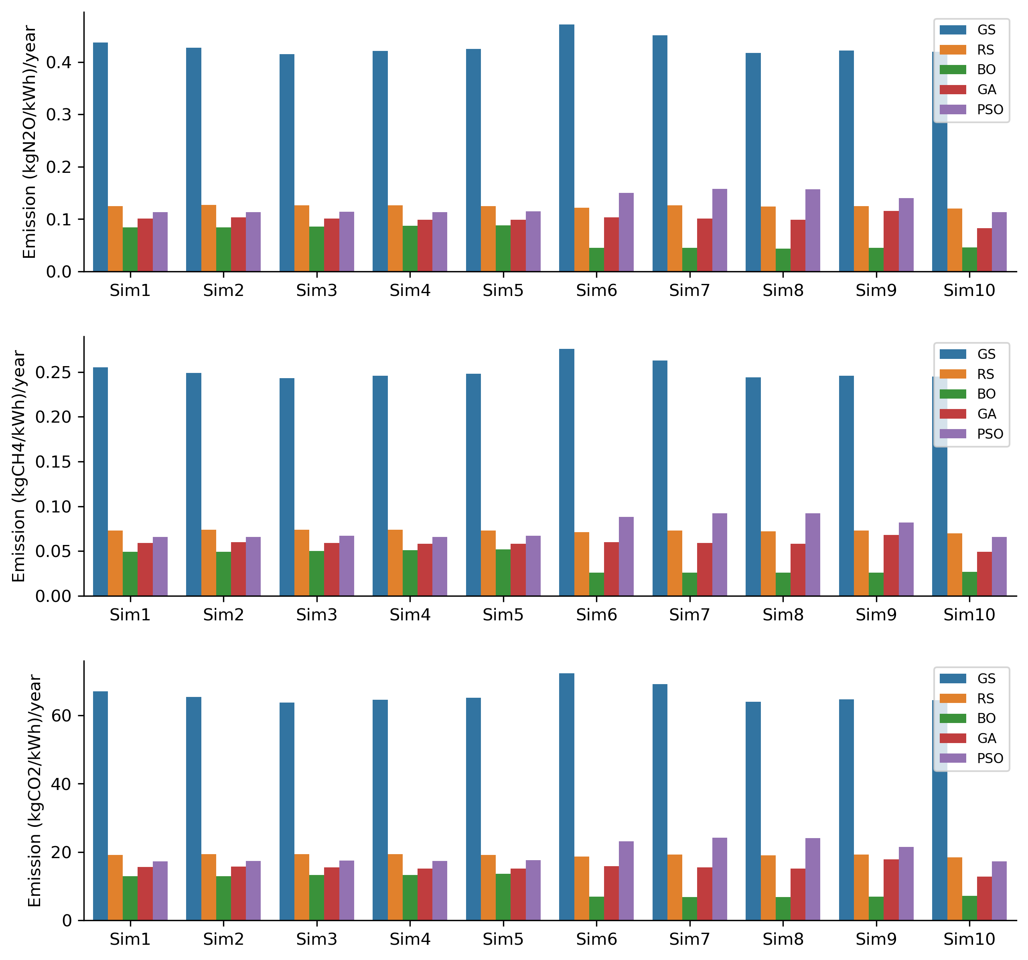
Different types of GHG emissions measured
CO2 is the most predominant gas emitted during the consumption of electricity in the UK, since its coefficient is the highest.

Slide 16
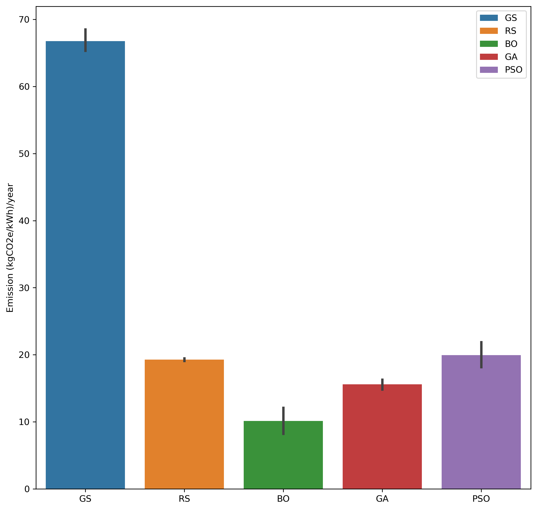
Average total CO2e emissions per year for each HPO algorithm
The estimated equivalent carbon footprint for one year differs between the algorithms according to execution time and the size of the search space to explore.

Slide 17
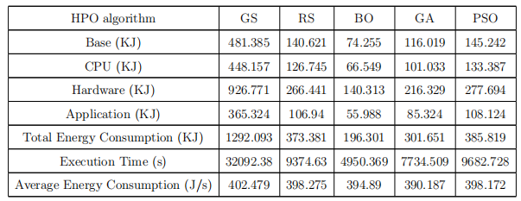
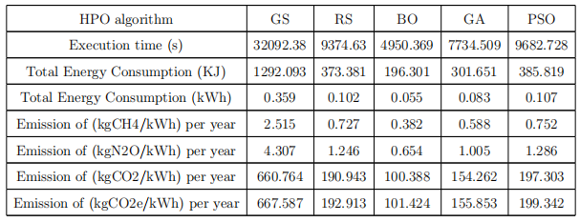
Aggregated results of energy consumption and GHG emissions
Aggregated energy consumption results of all simulations
Aggregated CO2 emissions results of all simulations

Slide 18

Inferential Analysis
Investigate the similarity between HPO algorithms
Perform a two-tailed t-test between each two algorithms.
The mean values of the simulation results are compared to one another for each algorithm while also assuming:
samples are unrelated
each sample comes from a population with a normal distribution.
samples come from populations with equal variances

Slide 19
4. Conclusion

Slide 20
Recommendations
Although GS offers the best possible solution, it is inefficient in terms of computational time so it should be avoided as a primary HPO approach.
It is advisable to employ energy tracking software in order to lower carbon footprint of ICT sector.
PSO, GA, and BO provide good quality solutions in a shorter time, which can be very useful for ML model development.

Slide 21
Conclusion and Future Work
A comparative analysis was conducted to evaluate five HPO algorithms in terms of energy consumption and emissions.
The results reveal that selecting the appropriate HP optimization algorithm is crucial as it can significantly impact the environment.
Possible future work may focus on deep learning models, which may require even more training time and computational resources.

Slide 22
Thank you for your attention!
Notes:
https://leedsbeckett-my.sharepoint.com/:f:/g/personal/n_arfi3554_student_leedsbeckett_ac_uk/EvzA-r1XkctJr4OD3iJiWdUBBdKWf_7v35uOrf_KyE_k0Q?e=xkx2S1

